Slide 1
Evidence of Evolution
[Your Name]

Slide 2
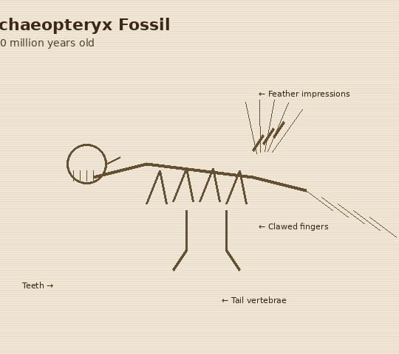
Paleontology – Archaeopteryx
Description:
• Lived about 150 million years ago during the late Jurassic period
• Had feathers and wings like a bird, but also teeth and clawed fingers like a dinosaur
• Found preserved in limestone in Germany
How does this support evolution?
Archaeopteryx is a transitional fossil that shows features of both dinosaurs and birds. This is evidence that modern birds gradually evolved from small feathered dinosaurs over millions of years. It fills in a gap between two major groups of animals.
Source: "Archaeopteryx." Britannica, britannica.com/animal/Archaeopteryx

Slide 3
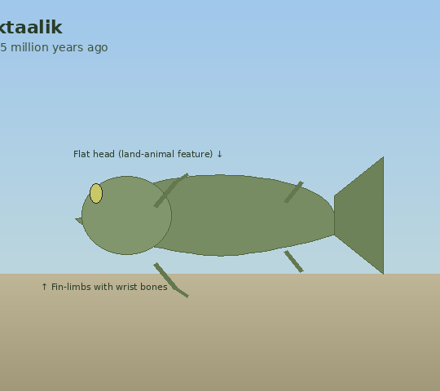
Paleontology – Tiktaalik
Description:
• Lived about 375 million years ago in shallow freshwater
• Had fins with internal bones resembling a wrist and arm
• Possessed a flat head and a neck, which are features not found in fish
How does this support evolution?
Tiktaalik is a transitional fossil between fish and four-legged land animals. Its fin-limbs with wrist-like bones show how land animals may have evolved from fish that developed limb structures. It helps explain the transition from aquatic to terrestrial life.
Source: "Tiktaalik." National Geographic, nationalgeographic.org/encyclopedia/tiktaalik

Slide 4
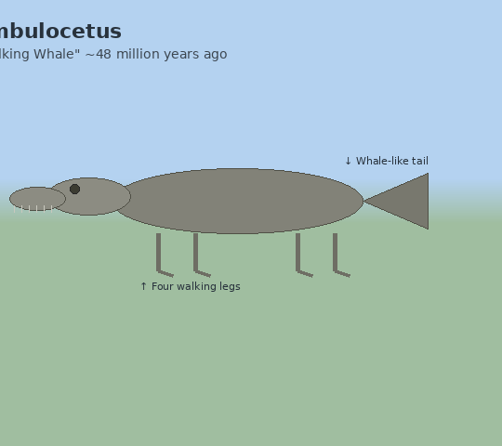
Paleontology – Ambulocetus
Description:
• Lived about 48 million years ago
• Had four legs but could swim by undulating its spine up and down
• Is an early ancestor of modern whales
How does this support evolution?
Ambulocetus, meaning "walking whale," is a transitional fossil showing that modern whales descended from four-legged land mammals. Its ability to both walk and swim demonstrates a step in the gradual shift from land to ocean living. This supports the idea that major body changes happen over millions of years.
Source: "Evidence of Evolution." Khan Academy, khanacademy.org/science/biology/her/evolution-and-natural-selection

Slide 5
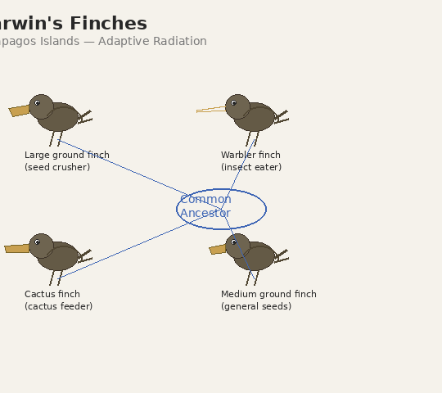
Biogeography – Darwin's Finches
Description:
• Found on the Galápagos Islands in the Pacific Ocean
• 14 different species, each with a uniquely shaped beak
• Each beak type is adapted to the specific food available on its island
How does this support evolution?
All 14 species descended from a single ancestor that arrived on the islands long ago. Over time, different populations adapted to different food sources through natural selection, resulting in different beak shapes. This is a classic example of adaptive radiation.
Source: "Darwin's Finches." Khan Academy, khanacademy.org/science/biology/her/evolution-and-natural-selection

Slide 6
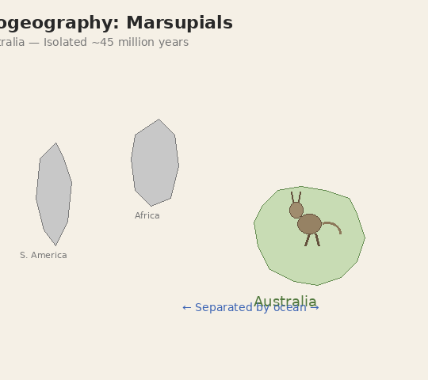
Biogeography – Marsupials in Australia
Description:
• Marsupials like kangaroos and koalas are found almost exclusively in Australia
• Australia separated from other continents around 45 million years ago
• Marsupials evolved in isolation from placental mammals on other continents
How does this support evolution?
Because Australia was geographically isolated, its mammals evolved along a completely separate path. The great diversity of marsupials found only in Australia shows that isolation drives unique evolutionary changes. This pattern of species being shaped by geography is key evidence for evolution.
Source: "Marsupial." Britannica, britannica.com/animal/marsupial

Slide 7
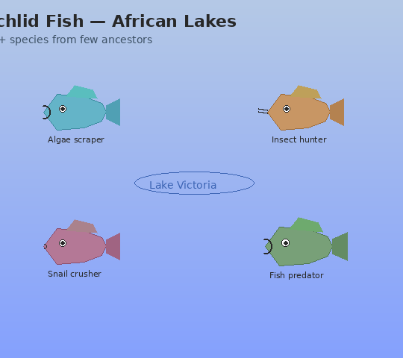
Biogeography – Cichlid Fish in African Lakes
Description:
• Over 500 species of cichlid fish live in Africa's Great Lakes
• Each species is adapted to eat a different type of food
• All species descended from just a few common ancestors
How does this support evolution?
Cichlid fish are one of the fastest-evolving groups of vertebrates on Earth. Isolated in separate lakes, small founding populations diversified into hundreds of species, each shaped by its environment. This rapid speciation in one geographic area is strong evidence that evolution is driven by environmental pressures.
Source: "Cichlid Evolution." National Geographic, nationalgeographic.com/animals/fish/facts/cichlids

Slide 8
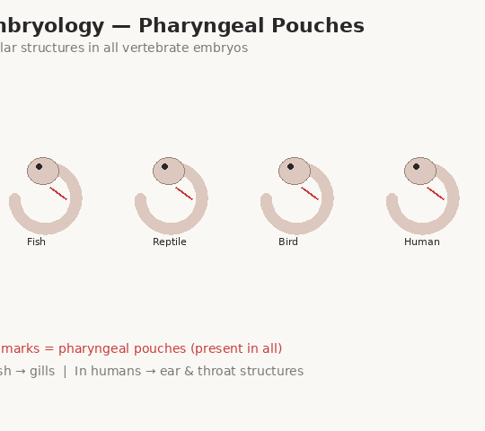
Embryology – Pharyngeal Pouches
Description:
• Fish, reptiles, birds, and humans all develop pharyngeal pouches as embryos
• In fish, these pouches develop into gills
• In humans, they become structures in the ear and throat
How does this support evolution?
The fact that very different animals share the same embryonic structures suggests they inherited them from a common ancestor. Over evolutionary time, the same starting structures were modified into different organs depending on the species. Shared embryonic development is strong evidence of a shared evolutionary past.
Source: "Embryology and Evolution." Khan Academy, khanacademy.org/science/biology/her/evolution-and-natural-selection

Slide 9
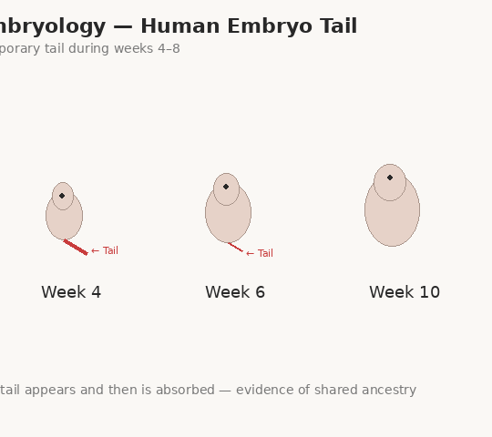
Embryology – Tail in Human Embryos
Description:
• Human embryos develop a small tail between weeks 4 and 8
• The tail is reabsorbed into the body before birth
• This tail matches the tails found in other vertebrate embryos
How does this support evolution?
The temporary tail in human embryos is a remnant of our evolutionary ancestry with other tailed mammals. It appears because the genetic instructions from our ancestors still briefly activate during development. This shows that humans share a common ancestor with other vertebrates that had tails.
Source: "Human Embryo Development." Britannica, britannica.com/science/human-embryology

Slide 10
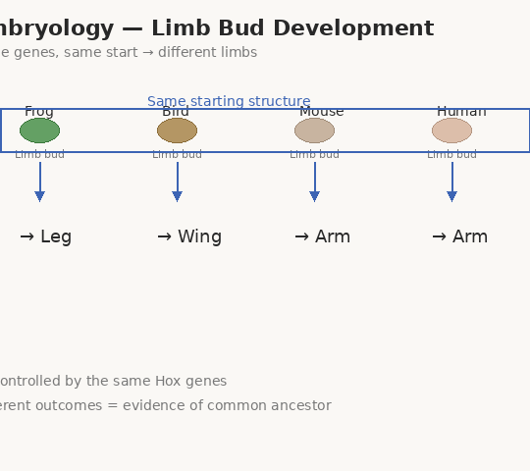
Embryology – Limb Bud Development
Description:
• All vertebrate embryos (frogs, birds, mice, humans) develop limb buds in the same basic pattern
• The same set of genes (Hox genes) controls limb growth across all these species
• These limb buds later develop into arms, wings, flippers, or legs
How does this support evolution?
The shared genetic blueprint for limb development across very different species points to a common ancestor. Evolution did not change how limbs begin forming; it changed how they end up looking in each species. This conserved developmental process is evidence that vertebrates are related.
Source: "Limb Development." NCBI / National Institutes of Health, ncbi.nlm.nih.gov/books/NBK10000

Slide 11
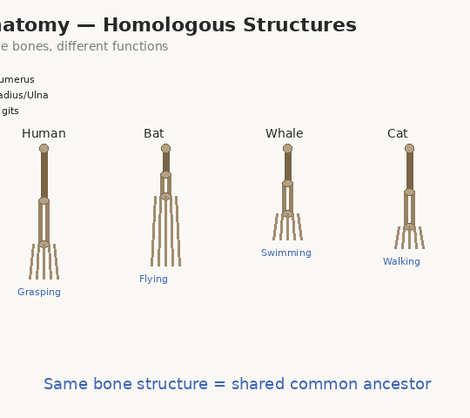
Anatomy – Homologous Structures
Description:
• Humans, bats, whales, and cats all share the same set of forelimb bones
• These bones are used for very different purposes: grasping, flying, swimming, walking
• Despite different functions, the underlying bone arrangement is the same
How does this support evolution?
Homologous structures are body parts that share the same skeletal plan because they were inherited from a common ancestor. Evolution modified the shape and size of these bones to fit each species' way of life. The shared blueprint is evidence that these animals are related through descent.
Source: "Homologous Structures." Khan Academy, khanacademy.org/science/biology/her/evolution-and-natural-selection

Slide 12
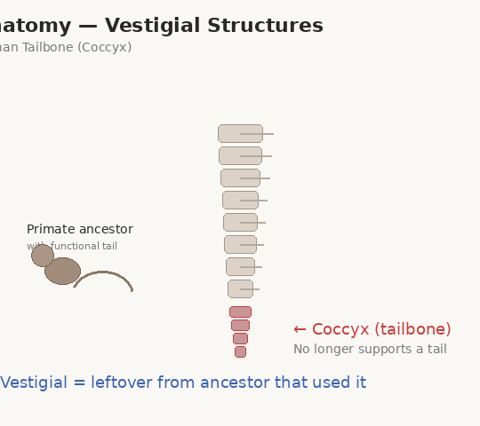
Anatomy – Vestigial Structures
Description:
• Humans have a small bone at the base of the spine called the coccyx (tailbone)
• It no longer supports a tail and has very little function
• Other primates and many mammals use a similar bone to support their tails
How does this support evolution?
The human tailbone is a vestigial structure — a body part left over from an ancestor that actually needed it. Its presence in humans, despite serving no purpose for a tail, shows we are descended from tailed ancestors. Vestigial structures are strong evidence that species change over time.
Source: "Vestigial Organ." Britannica, britannica.com/science/vestigial-organ

Slide 13
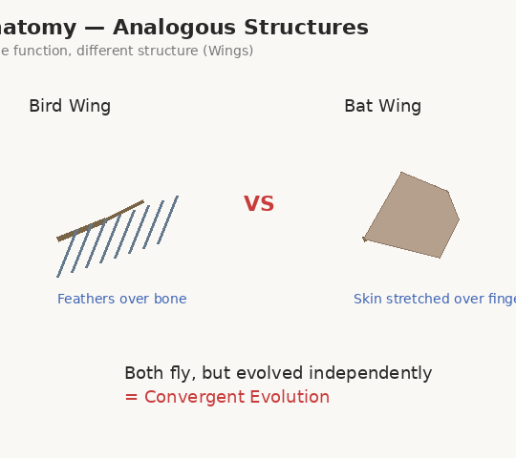
Anatomy – Analogous Structures
Description:
• Birds and bats both have wings used for flight
• Bird wings are made of feathers over bone; bat wings are skin stretched over elongated fingers
• They evolved flight independently from different ancestors
How does this support evolution?
Analogous structures show that unrelated species can independently evolve similar features to solve the same problem. This process, called convergent evolution, demonstrates that natural selection shapes organisms in predictable ways. It proves that evolution responds to environmental pressures.
Source: "Convergent Evolution." National Geographic, nationalgeographic.org/encyclopedia/convergent-evolution

Slide 14
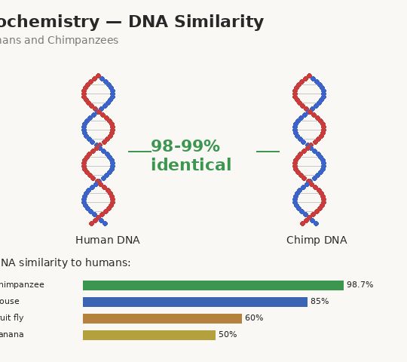
Biochemistry – DNA Similarity
Description:
• Human DNA and chimpanzee DNA are about 98–99% identical
• Small DNA differences account for physical differences like brain size
• More closely related species share more similar DNA sequences
How does this support evolution?
The near-identical DNA between humans and chimps is strong molecular evidence that both species share a recent common ancestor. Small mutations accumulated over millions of years can lead to significant physical differences. DNA comparison allows scientists to measure how closely related any two species are.
Source: "Molecular Evidence for Evolution." Khan Academy, khanacademy.org/science/biology/her/evolution-and-natural-selection

Slide 15
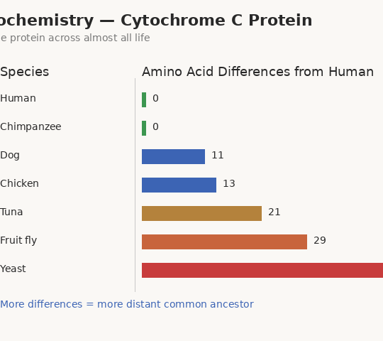
Biochemistry – Cytochrome C Protein
Description:
• Cytochrome c is a protein used in energy production, found in nearly all living things
• The human version is nearly identical to other mammals' versions
• More distantly related organisms like yeast have a more different version
How does this support evolution?
The fact that the same essential protein exists across nearly all life — with only small variations — shows all organisms evolved from a common ancestor. The number of amino acid differences between species corresponds to how long ago they diverged. This molecular clock helps scientists map the tree of life.
Source: "Cytochrome." Britannica, britannica.com/science/cytochrome

Slide 16
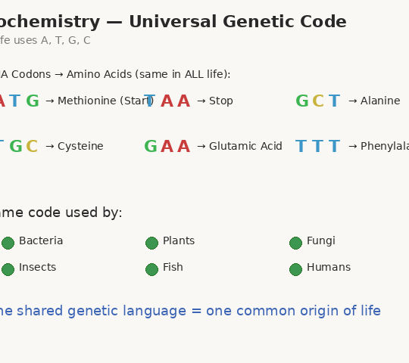
Biochemistry – Universal Genetic Code
Description:
• All living things on Earth use the same DNA bases: A, T, G, and C
• The same three-letter codons code for the same amino acids in all organisms
• This includes bacteria, plants, fungi, and animals
How does this support evolution?
The universal genetic code is perhaps the strongest biochemical evidence for evolution. The fact that every living organism on Earth uses the same molecular language strongly suggests all life shares a single common origin. Evolution built on this original code, diversifying it into the enormous variety of life we see today.
Source: "Universal Genetic Code." Khan Academy, khanacademy.org/science/biology/gene-expression-central-dogma

